Slide 1
CS3300 – Introduction to Software Engineering
John Doe Portfolio
March 5th, 2025
Department of Computer Science
University of Colorado, Colorado Springs
Spring 2025

Slide 2
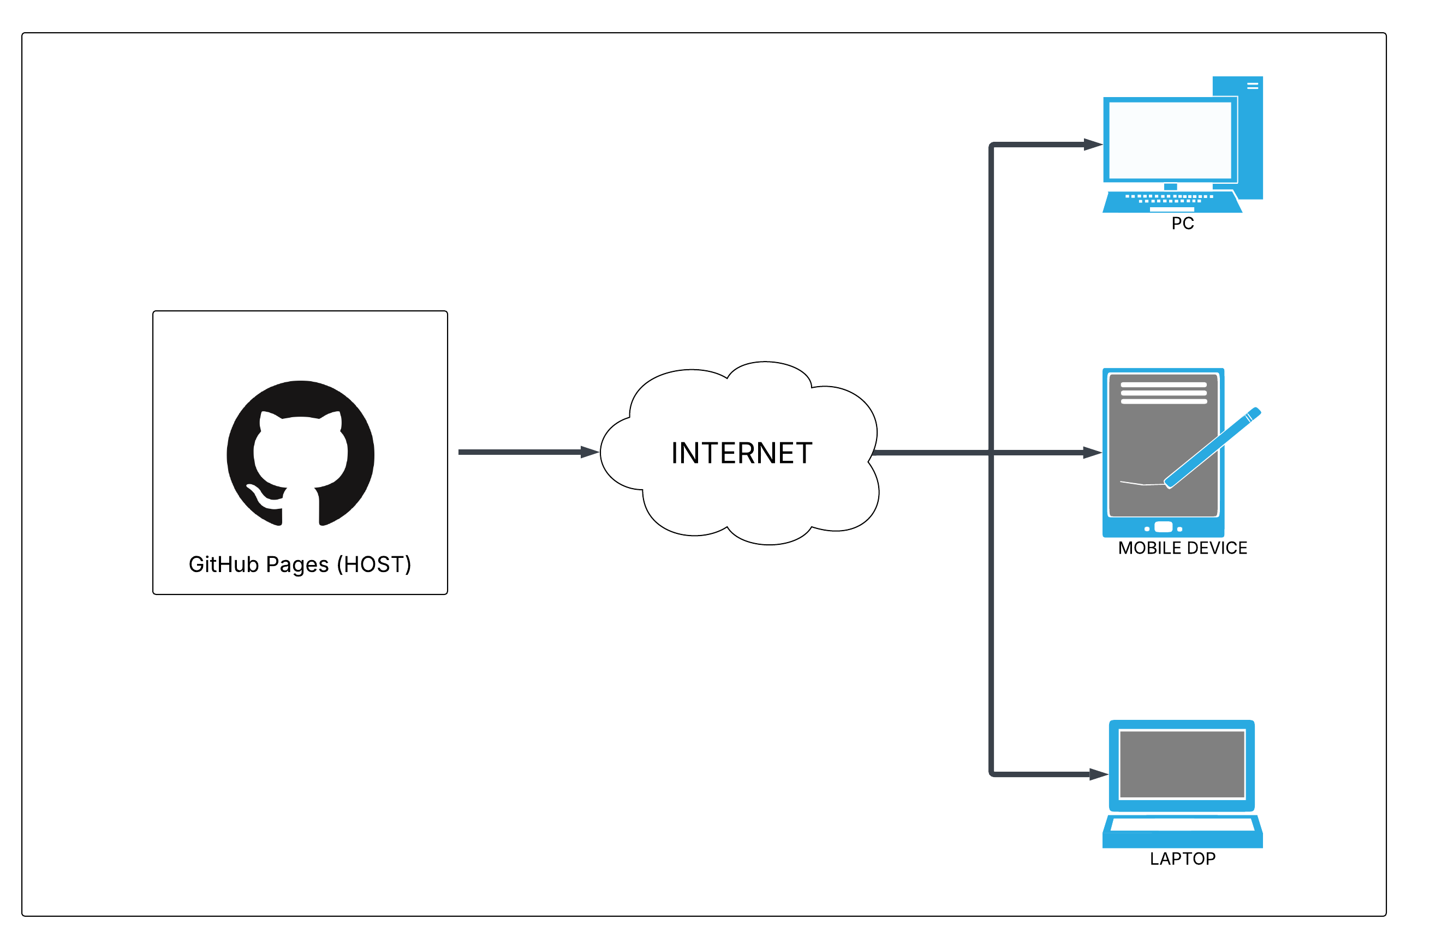
Architecture Diagram
The architecture diagram for our project is fairly straightforward since GitHub Pages is a static site host.
Date
Name

Slide 3
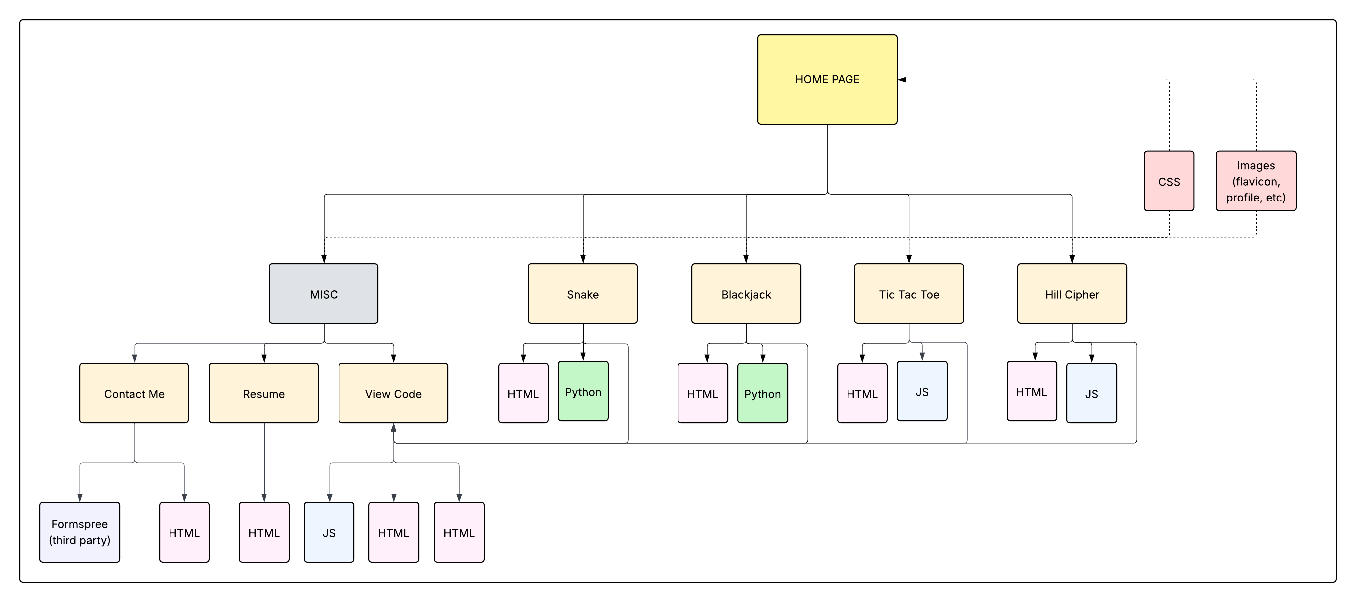
Software Design Diagram
Date
Name

Slide 4
Date
Name

Slide 5
Questions???

